Slide 1


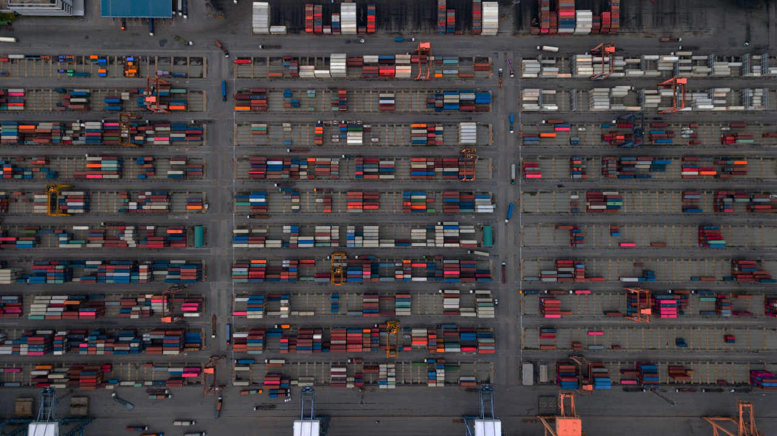

Containerisierung at Swiss Post IT
Technische Angaben
Bildgrösse:
Vollflächig
B 33,87 cm x H 19,05 cm
entsprechen
B 2000 Pixel x H 1125 Pixel
Auflösung 150 dpi
Bilder einfügen:
«Post-Menü > Bild»
Weitere Bilder unter www.brandingnet.ch

Slide 2

What are we doing today? Table of Content
Introducing round
Middleware Engineering
What is a Container?
Docker Container Introduction
Docker installation
Docker Examples
Hello World
Webserver
WikiJS
Filebrowser
Gitea
Kubernetes Demo

Slide 3
Introducing Round Who are we? Who are you?

Slide 4
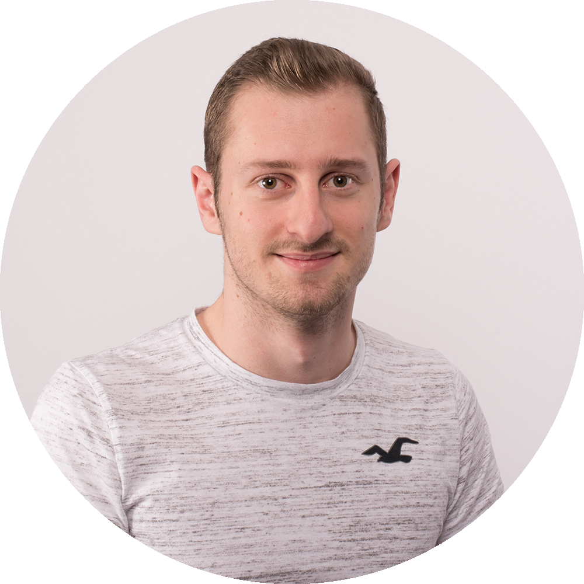
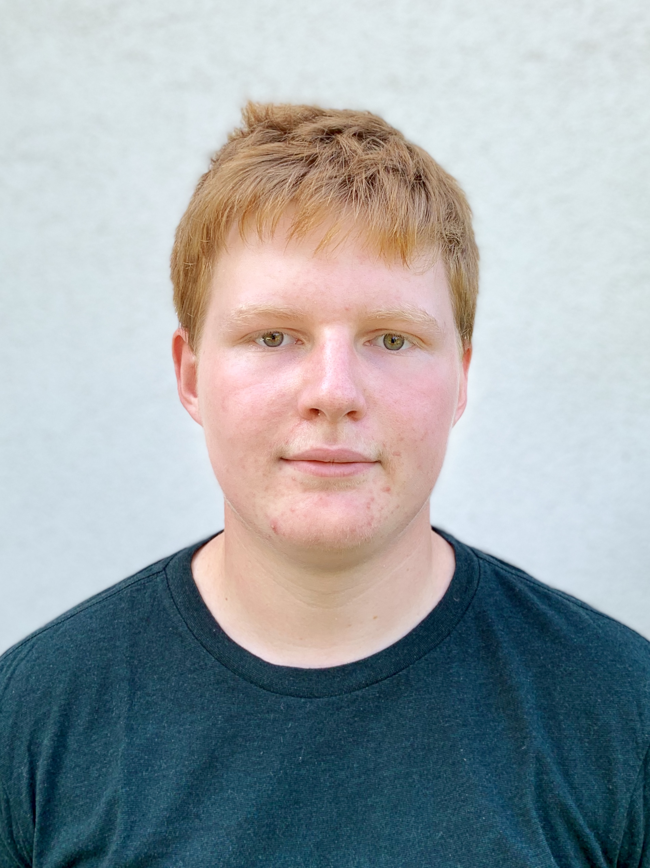
Who we are
Patrick Bühlmann Middleware Engineering
Nathanael Liechti Middleware Engineering - Lernender
Work area:
Kubernetes / OpenShift Engineering
Docker, Cloud, Automation
DevOps CI / CD
Work area:
Kubernetes Engineering
Go Coding (Microservices and more)
+41 76 342 82 59
+41 76 416 81 33
-
-
patrick.buehlmann.1@post.ch
nathanael.liechti@post.ch

Slide 5
Who are you? A short introduction
What is your name?
Do you have experience with Docker, Kubernetes or Container in general?
How motivated are you from a scale of 0 (terrible) to 10 (very good)?
Notes:
About 20-30s each

Slide 6
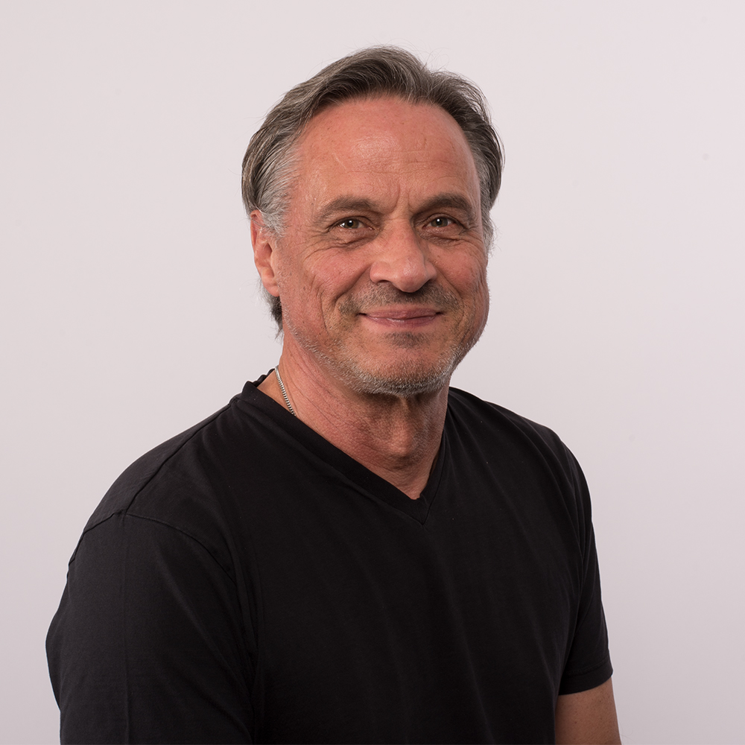
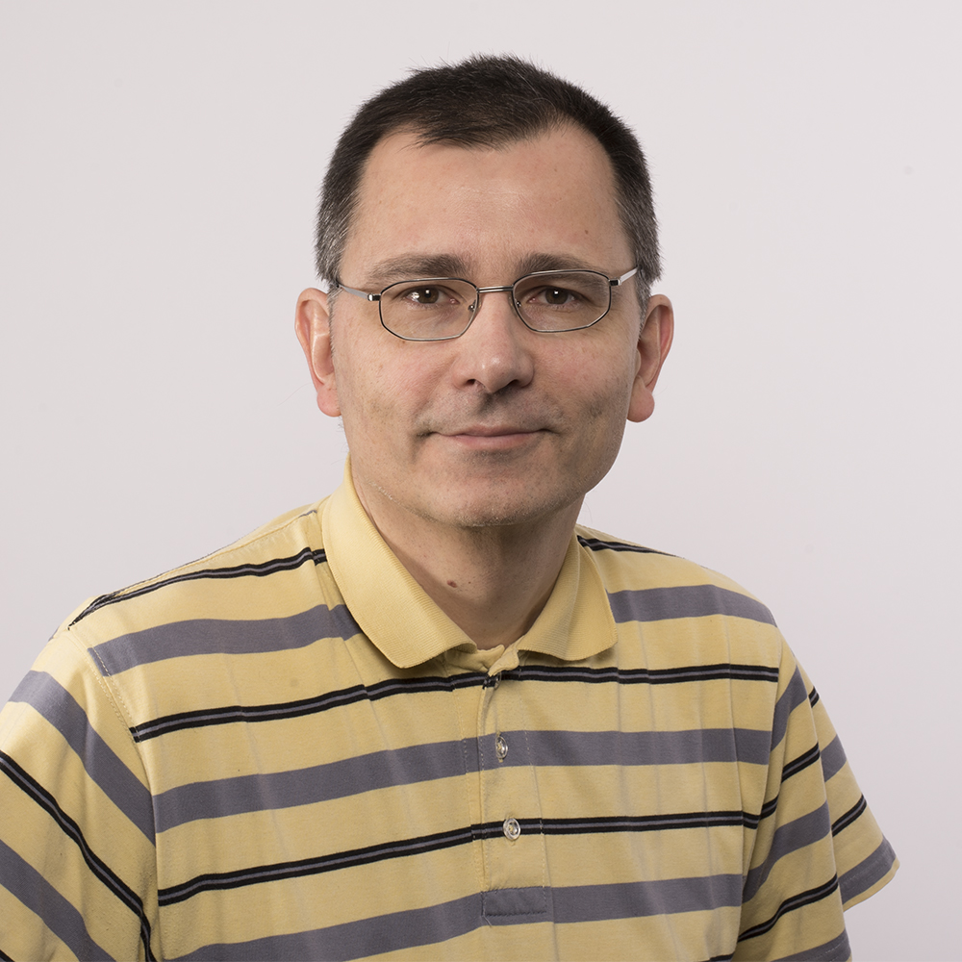
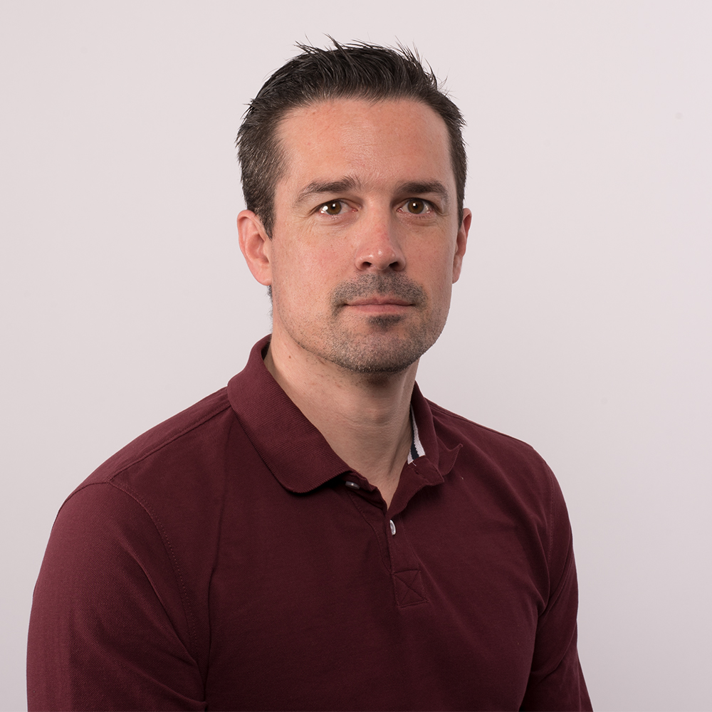
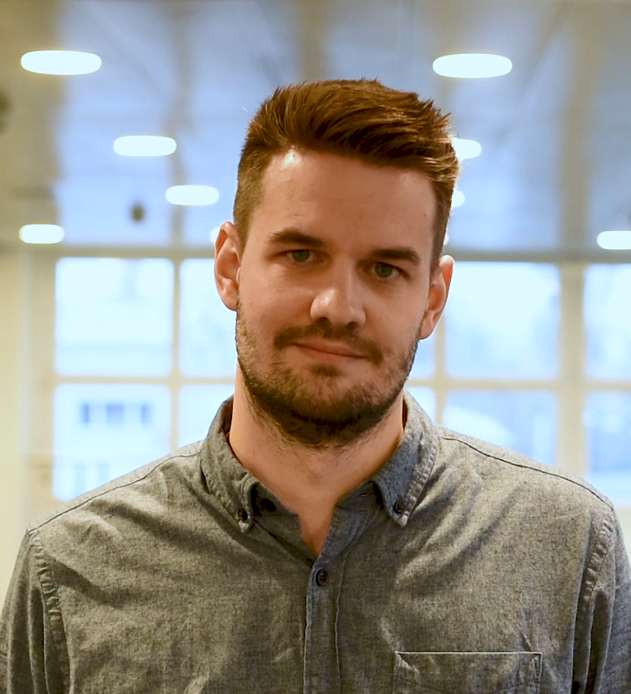
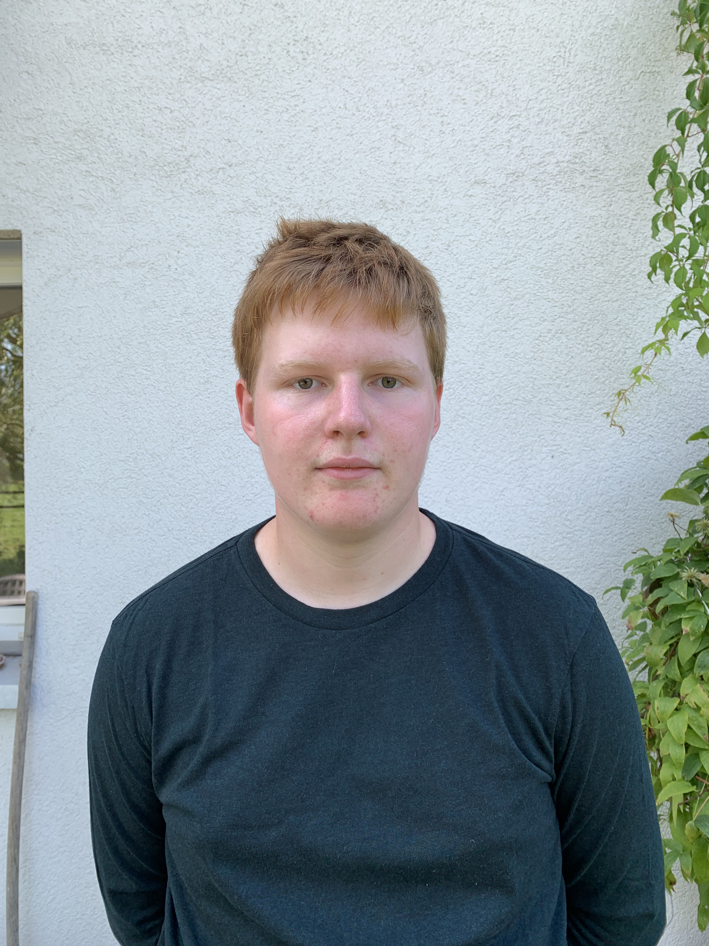

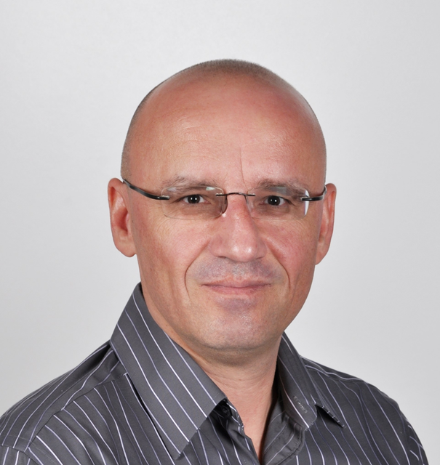
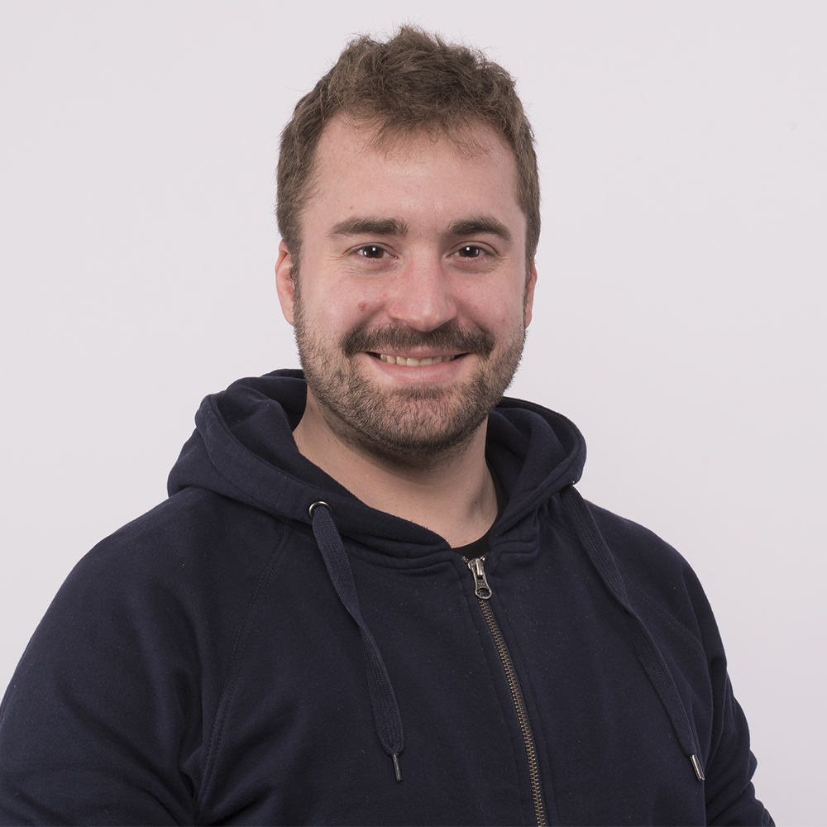
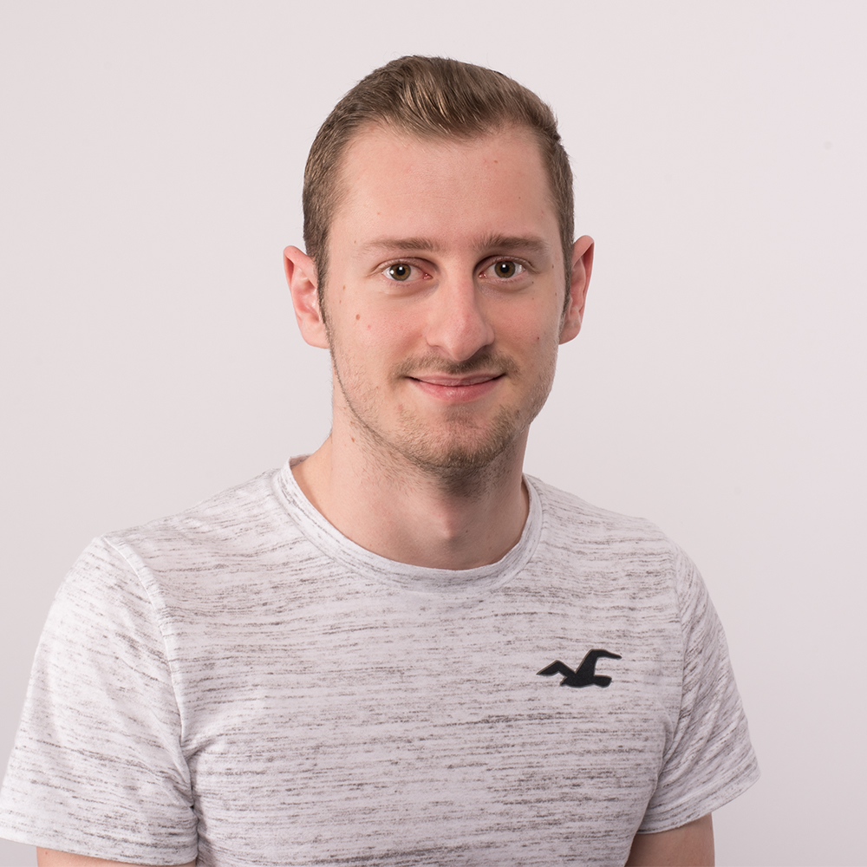
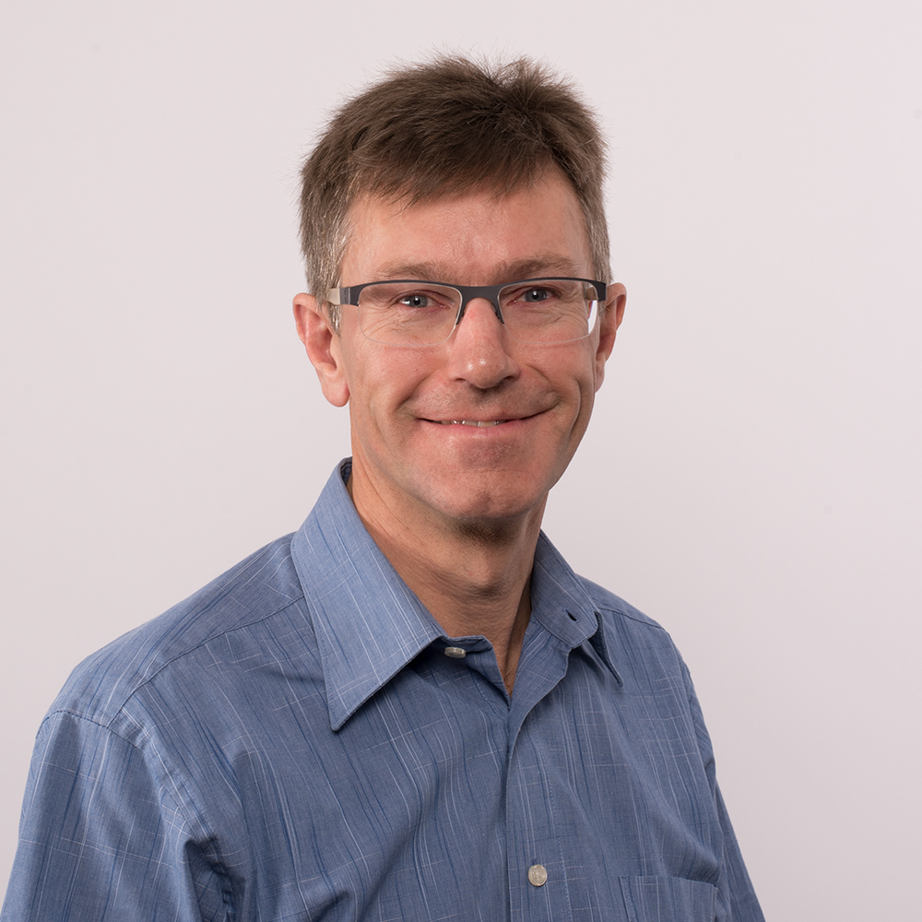
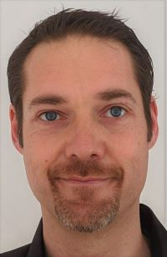

Middleware Engineering – I253 Our team
Notes:
There are more people now shown here

Slide 7
Middleware Engineering What is Engineering?
Systematic design of computer science systems
Create and implement concepts / products
ICT-System-Ingenieur:
Planning, procurement, commissioning, testing and acceptance of platforms (hardware, software, networks, including cloud environments) for the operation of ICT systems; definition of operational requirements
https://www.berufe-der-ict.ch/berufe/entwicklung/ict-system-ingenieur

Slide 8

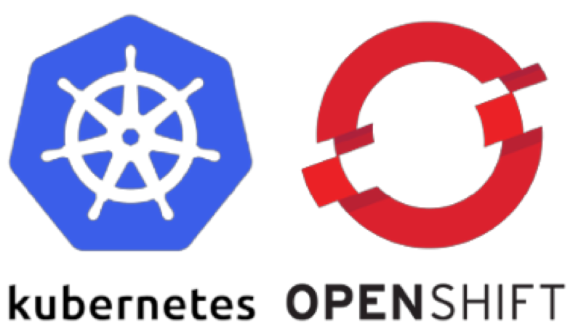
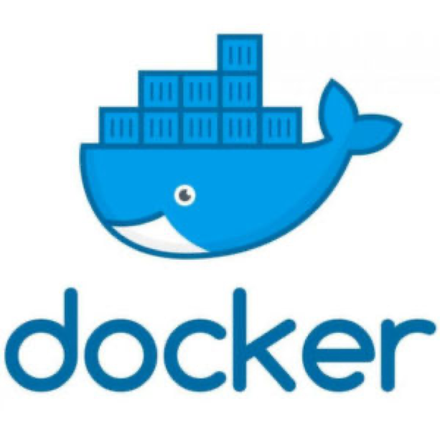







Middleware Engineering Engineering Tools
Notes:
Azure may come in the future

Slide 9
Middleware Engineering What does an Engineer do in his daily business?
Scripts, Automate everything (seriously, everything!)
Terminal, Shell
Work with Linux all day long
Searching and developing new solutions
Try somthing new
Questioning the existing
Interest in system / network / cloud
Notes:
Sometimes we really automate stuff that makes zero sense to automate (automatic mails because there is no API, Module Tests for things you touch 4 times a year…)

Slide 10

Docker Container Installation of Docker
https://www.digitalocean.com/community/tutorials/how-to-install-and-use-docker-on-debian-10
Notes:
Edit: We install docker now as a Container software and do the theory later as Patrick is in another meeting

Slide 11
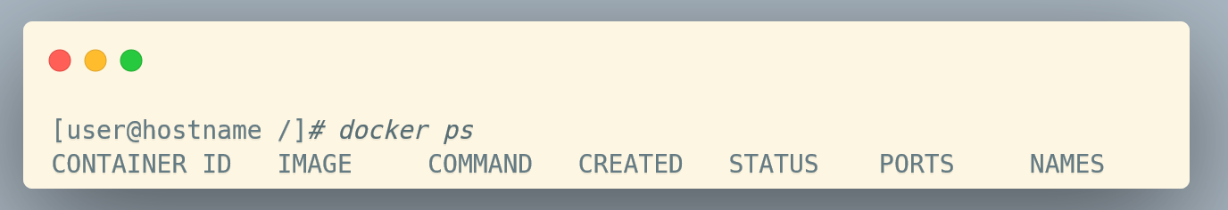
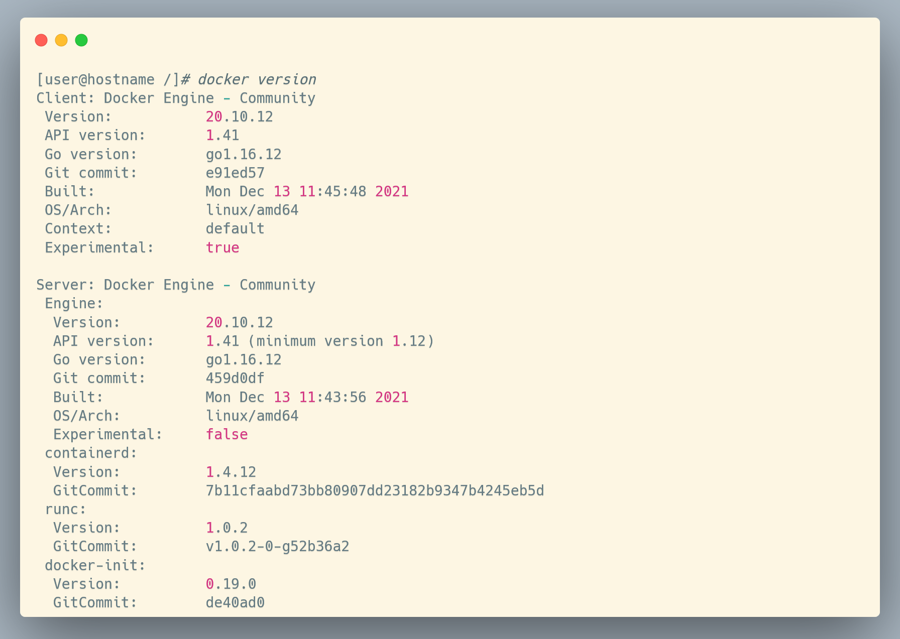
Docker Container Installation of Docker – Smoke-Tests
Notes:
Docker info / docker version = docker daemon running?

Slide 12
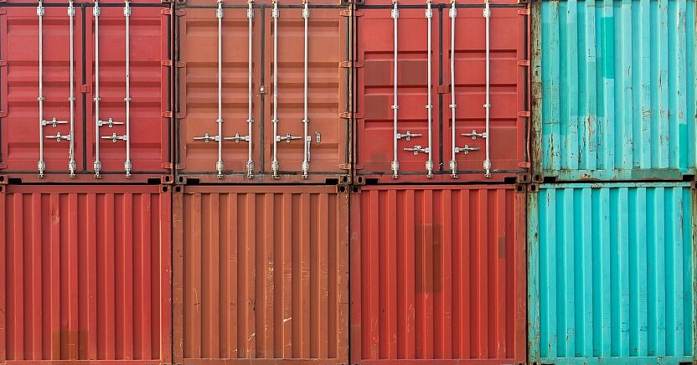
Container What is a container?

Slide 13
Container What is a Container?
“Containers are a form of operating system virtualization. A single container might be used to run anything from a small microservice or software process to a larger application. Inside a container are all the necessary executables, binary code, libraries, and configuration files. Compared to server or machine virtualization approaches, however, containers do not contain operating system images. This makes them more lightweight and portable, with significantly less overhead. In larger application deployments, multiple containers may be deployed as one or more container clusters.
Such clusters might be managed by a container orchestrator such as Kubernetes.”

Slide 14
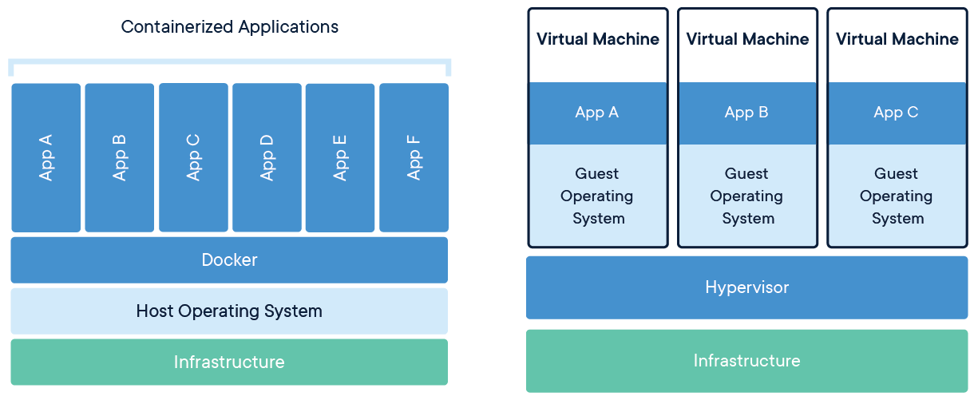
Container Comparison between Container and Virtual Machines
Share kernel and isolate the application process
Extremly portable
Very lightweight
One process in a container
No data in a container (use volumes)

Slide 15
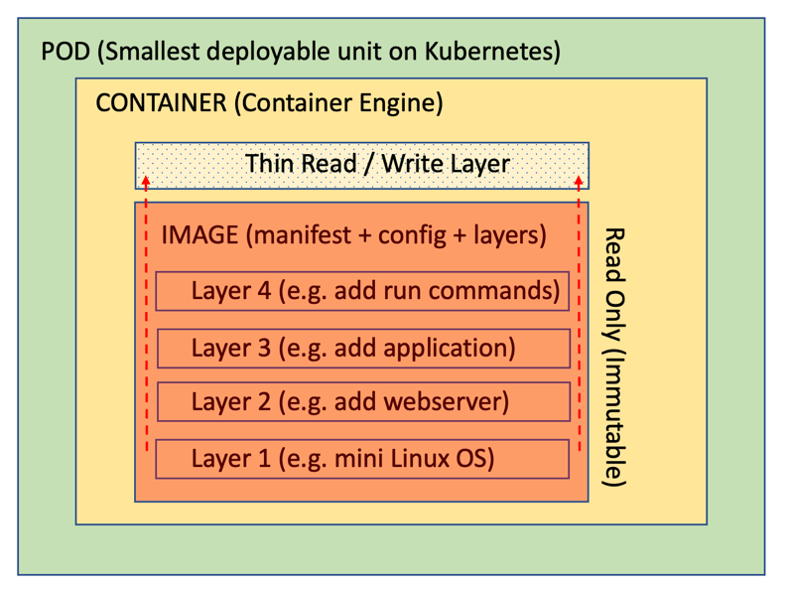
Container Inside of a Container

Slide 16
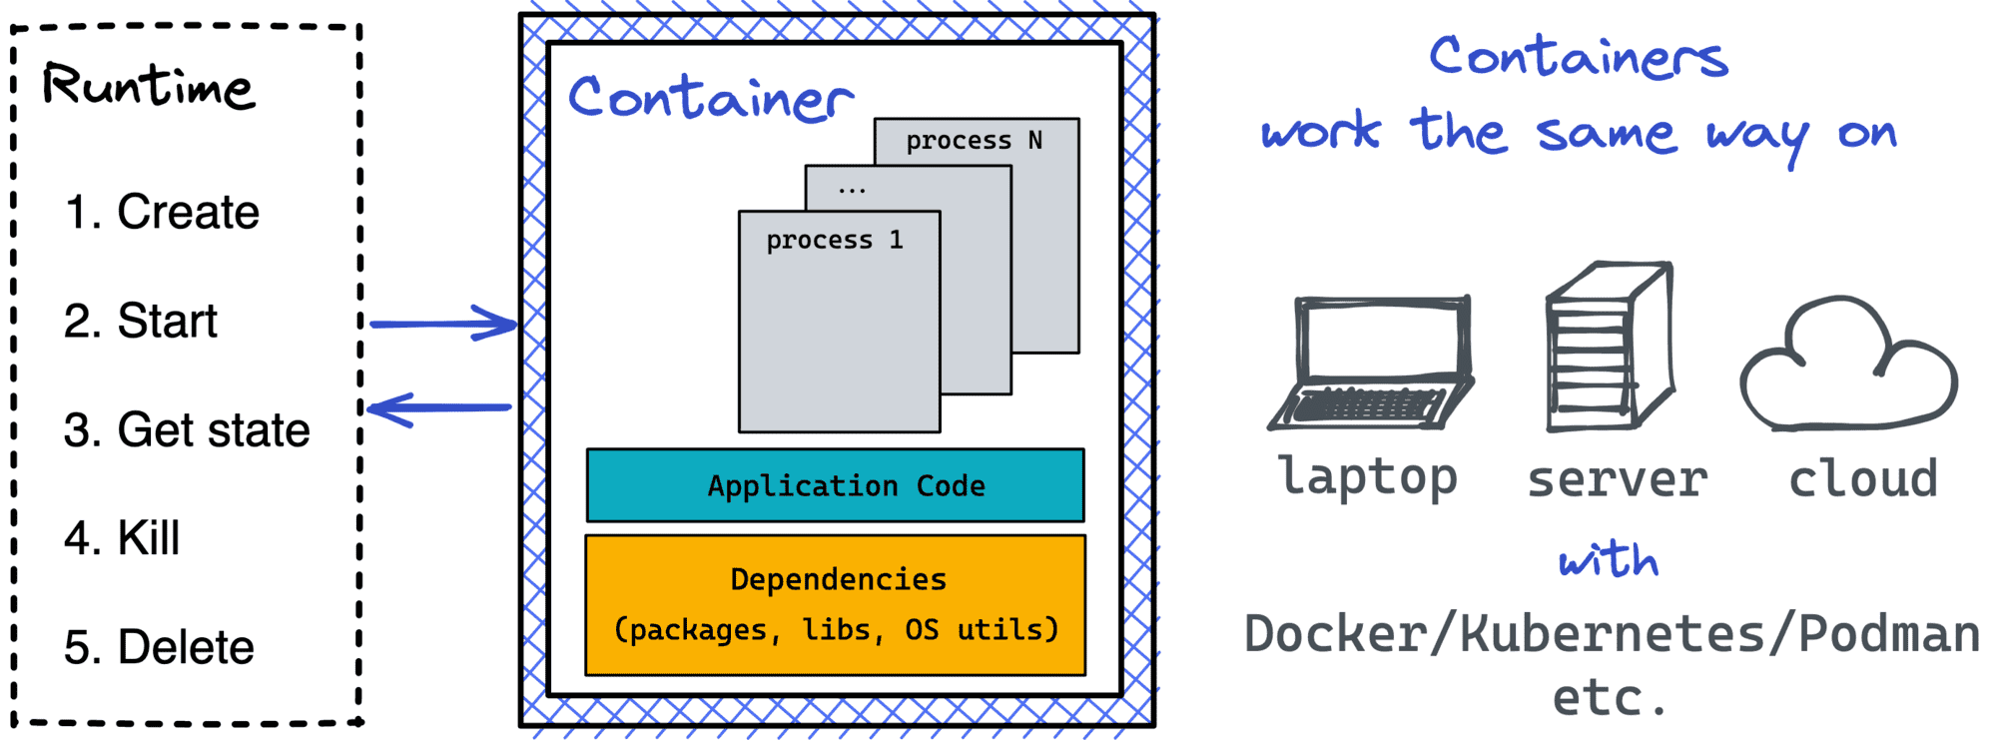
Container Interact with a Container

Slide 17

Container Benefits of containers
Less overhead
Increased portability
More consistent operation
Greater efficiency
Easier application development (less dependencies)
Much faster deployment
Save costs
Notes:
Less overhead Containers require less system resources than traditional or hardware virtual machine environments because they don’t include operating system images.
Increased portability Applications running in containers can be deployed easily to multiple different operating systems and hardware platforms.
More consistent operation DevOps teams know applications in containers will run the same, regardless of where they are deployed.
Greater efficiency Containers allow applications to be more rapidly deployed, patched, or scaled.
Better application development Containers support agile and DevOps efforts to accelerate development, test, and production cycles.

Slide 18
Docker Create, deploy and run Containers
Notes:
One of many software that helps using containers
Containers != docker
Docker = containers

Slide 19
Docker What is Docker?
Docker is a software platform designed to make it easier to create, deploy, and run applications by using containers. It allows developers to package up an application with all the parts it needs in a container, and then ship it out as one package.
Build, share and run any application, anywhere
Notes:
There are other softwares that can do the same

Slide 20
Docker Container Docker Mechanism
Repository
Host
Image
Container
Registry
Docker Client
Daemon

Slide 21
Docker Container Workflow
Image
Container
Build
Run
Pull
Stop
Delete
Delete

Slide 22
Docker Container Docker Engine Commands
Container
Image
build
pull
tag
Rmi
logs
inspect
ps
Stop
kill
rm
bhjhfdjhfjdshshfdjfhsfkjdshfkjhsjhfdkjhf
run
start

Slide 23
Docker Container Installation of Docker
https://www.digitalocean.com/community/tutorials/how-to-install-and-use-docker-on-debian-10
Notes:
Docker info / docker version = läuft der Prozess?

Slide 24
Docker Container Installation of Docker – Smoke-Tests
Notes:
Docker info / docker version = docker daemon running?

Slide 25
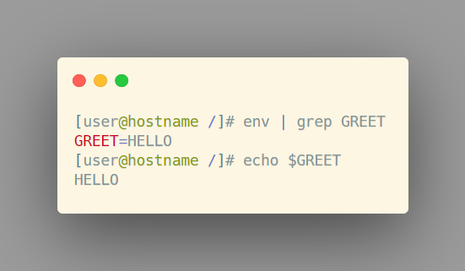
Docker Container Docker Runtime environment variables
Environment Variables docker run –it \ -e GREET=HELLO \ --rm centos

Slide 26
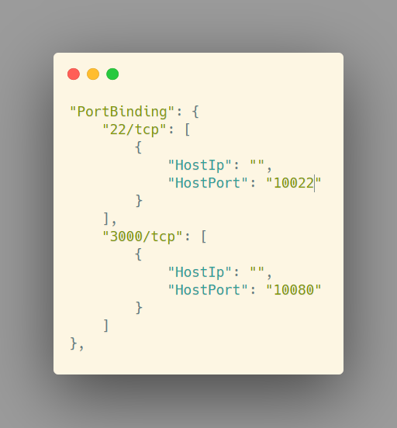
Docker Container Docker Runtime networking
Port translation docker run … -p 10022:22 …

Slide 27
Docker Container Docker Runtime volumes
Mount a directory from the host into the container docker run … -v /data/db:/var/lib/db …

Slide 28
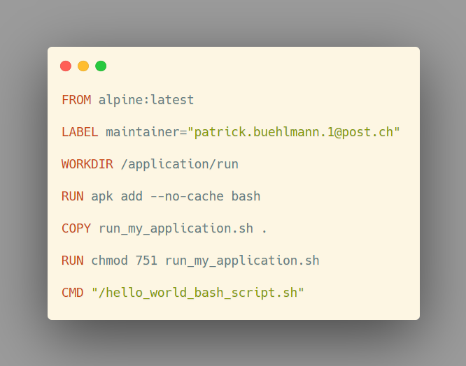

Docker Container The dockerfile is the truth
Dockerfile
Image
Container
Instruction-bases image build
FROM, ADD, RUN, COPY, CMD, USER
Cached layers
Dockerfile Cheat Sheet

Slide 29
DOCKER EXERCISE «Pre Hello World»

Slide 30
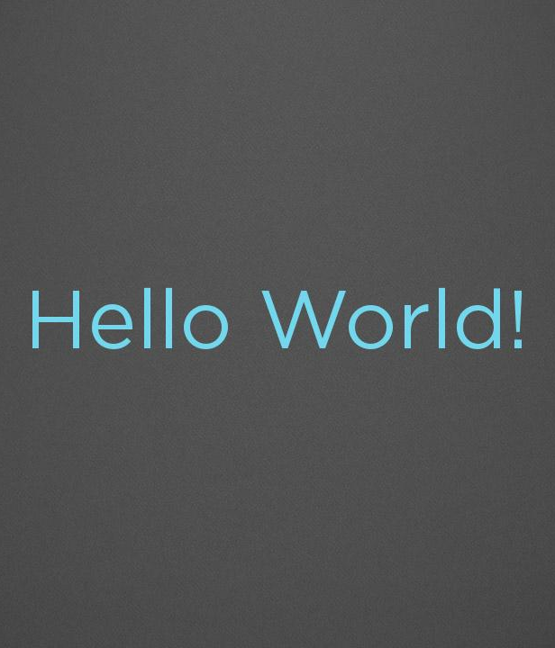

Docker Exercise Pre Hello World
docker run hello-world
docker ps –a
docker images

Slide 31
DOCKER EXERCISE «Hello World»

Slide 32
Docker Exercise Hello World
Write a Dockerfile that echos «Hello World!» when the container starts
Choose the right, small base image (alpine, centos)
Create a bash script to echo «Hello World!»
Build and run the container
Is there a faster way?
Notes:
Live begleitet durch Pädi

Slide 33
DOCKER EXERCISE «Webserver»

Slide 34
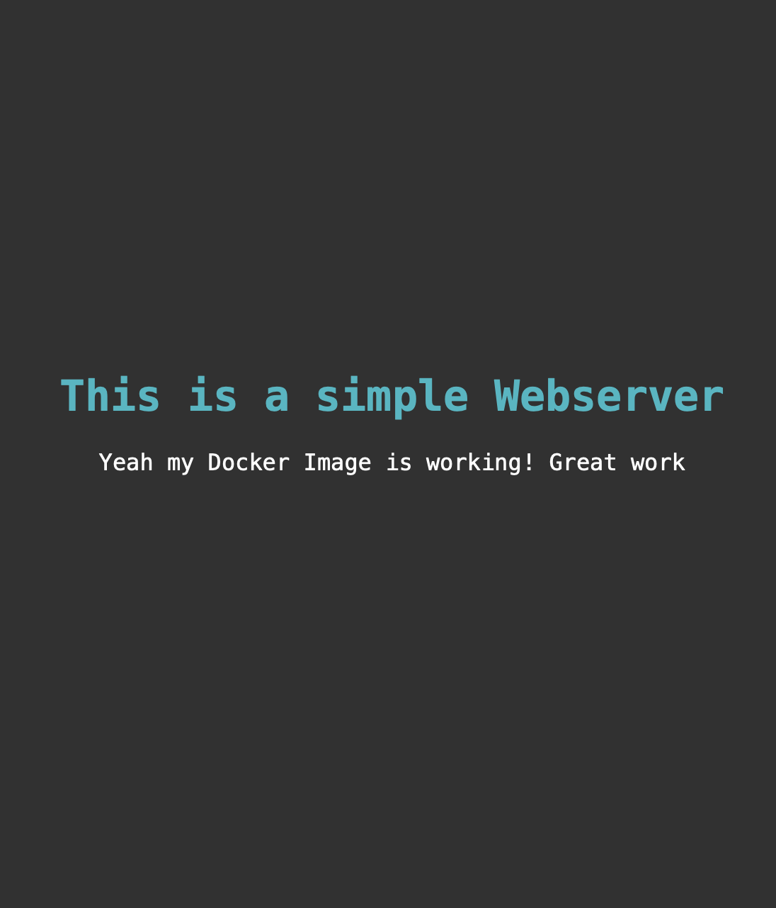
Docker Exercise Webserver
Write a Dockerfile for a Webserver showing your custom little HTML Page
Choose the right, small base image (alpine, centos)
Install an apache http server
Create an index.html file and paste it to the web folder of the apache server
Build and run the container in the detached mode (background)
Start the images«helloworld» and «webserver» with a docker-compose file
Notes:
Live begleitet durch Pädi

Slide 35
DOCKER EXERCISE «WikiJS»

Slide 36
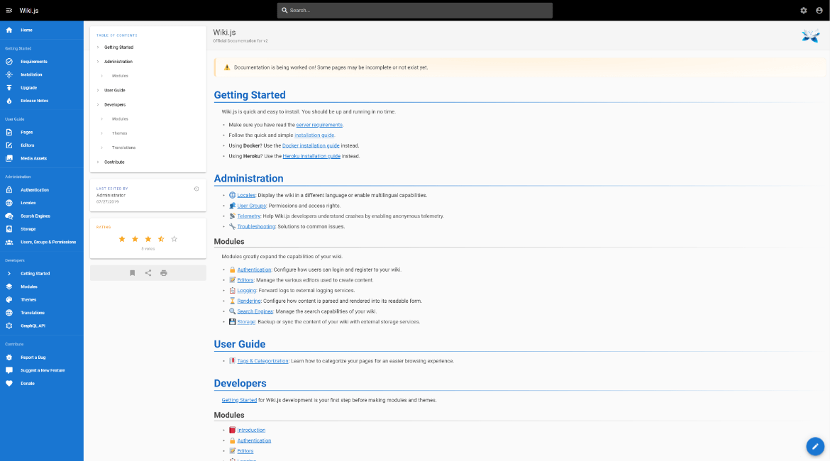

Docker Exercise WikiJS
Run a wikijs container
ENV=DB_TYPE=sqlite
ENV=DB_FILEPATH=/wiki/wiki.sqlite
Mount wiki.sqlite as File
Expose port 3000
Finish the setup of wikijs on http://localhost:3000
Write your first wiki-page!
https://docs.requarks.io/install/docker
Notes:
Image can be found in the docs: https://docs.requarks.io/install/docker

Slide 37
DOCKER EXERCISE «Filebrowser»

Slide 38
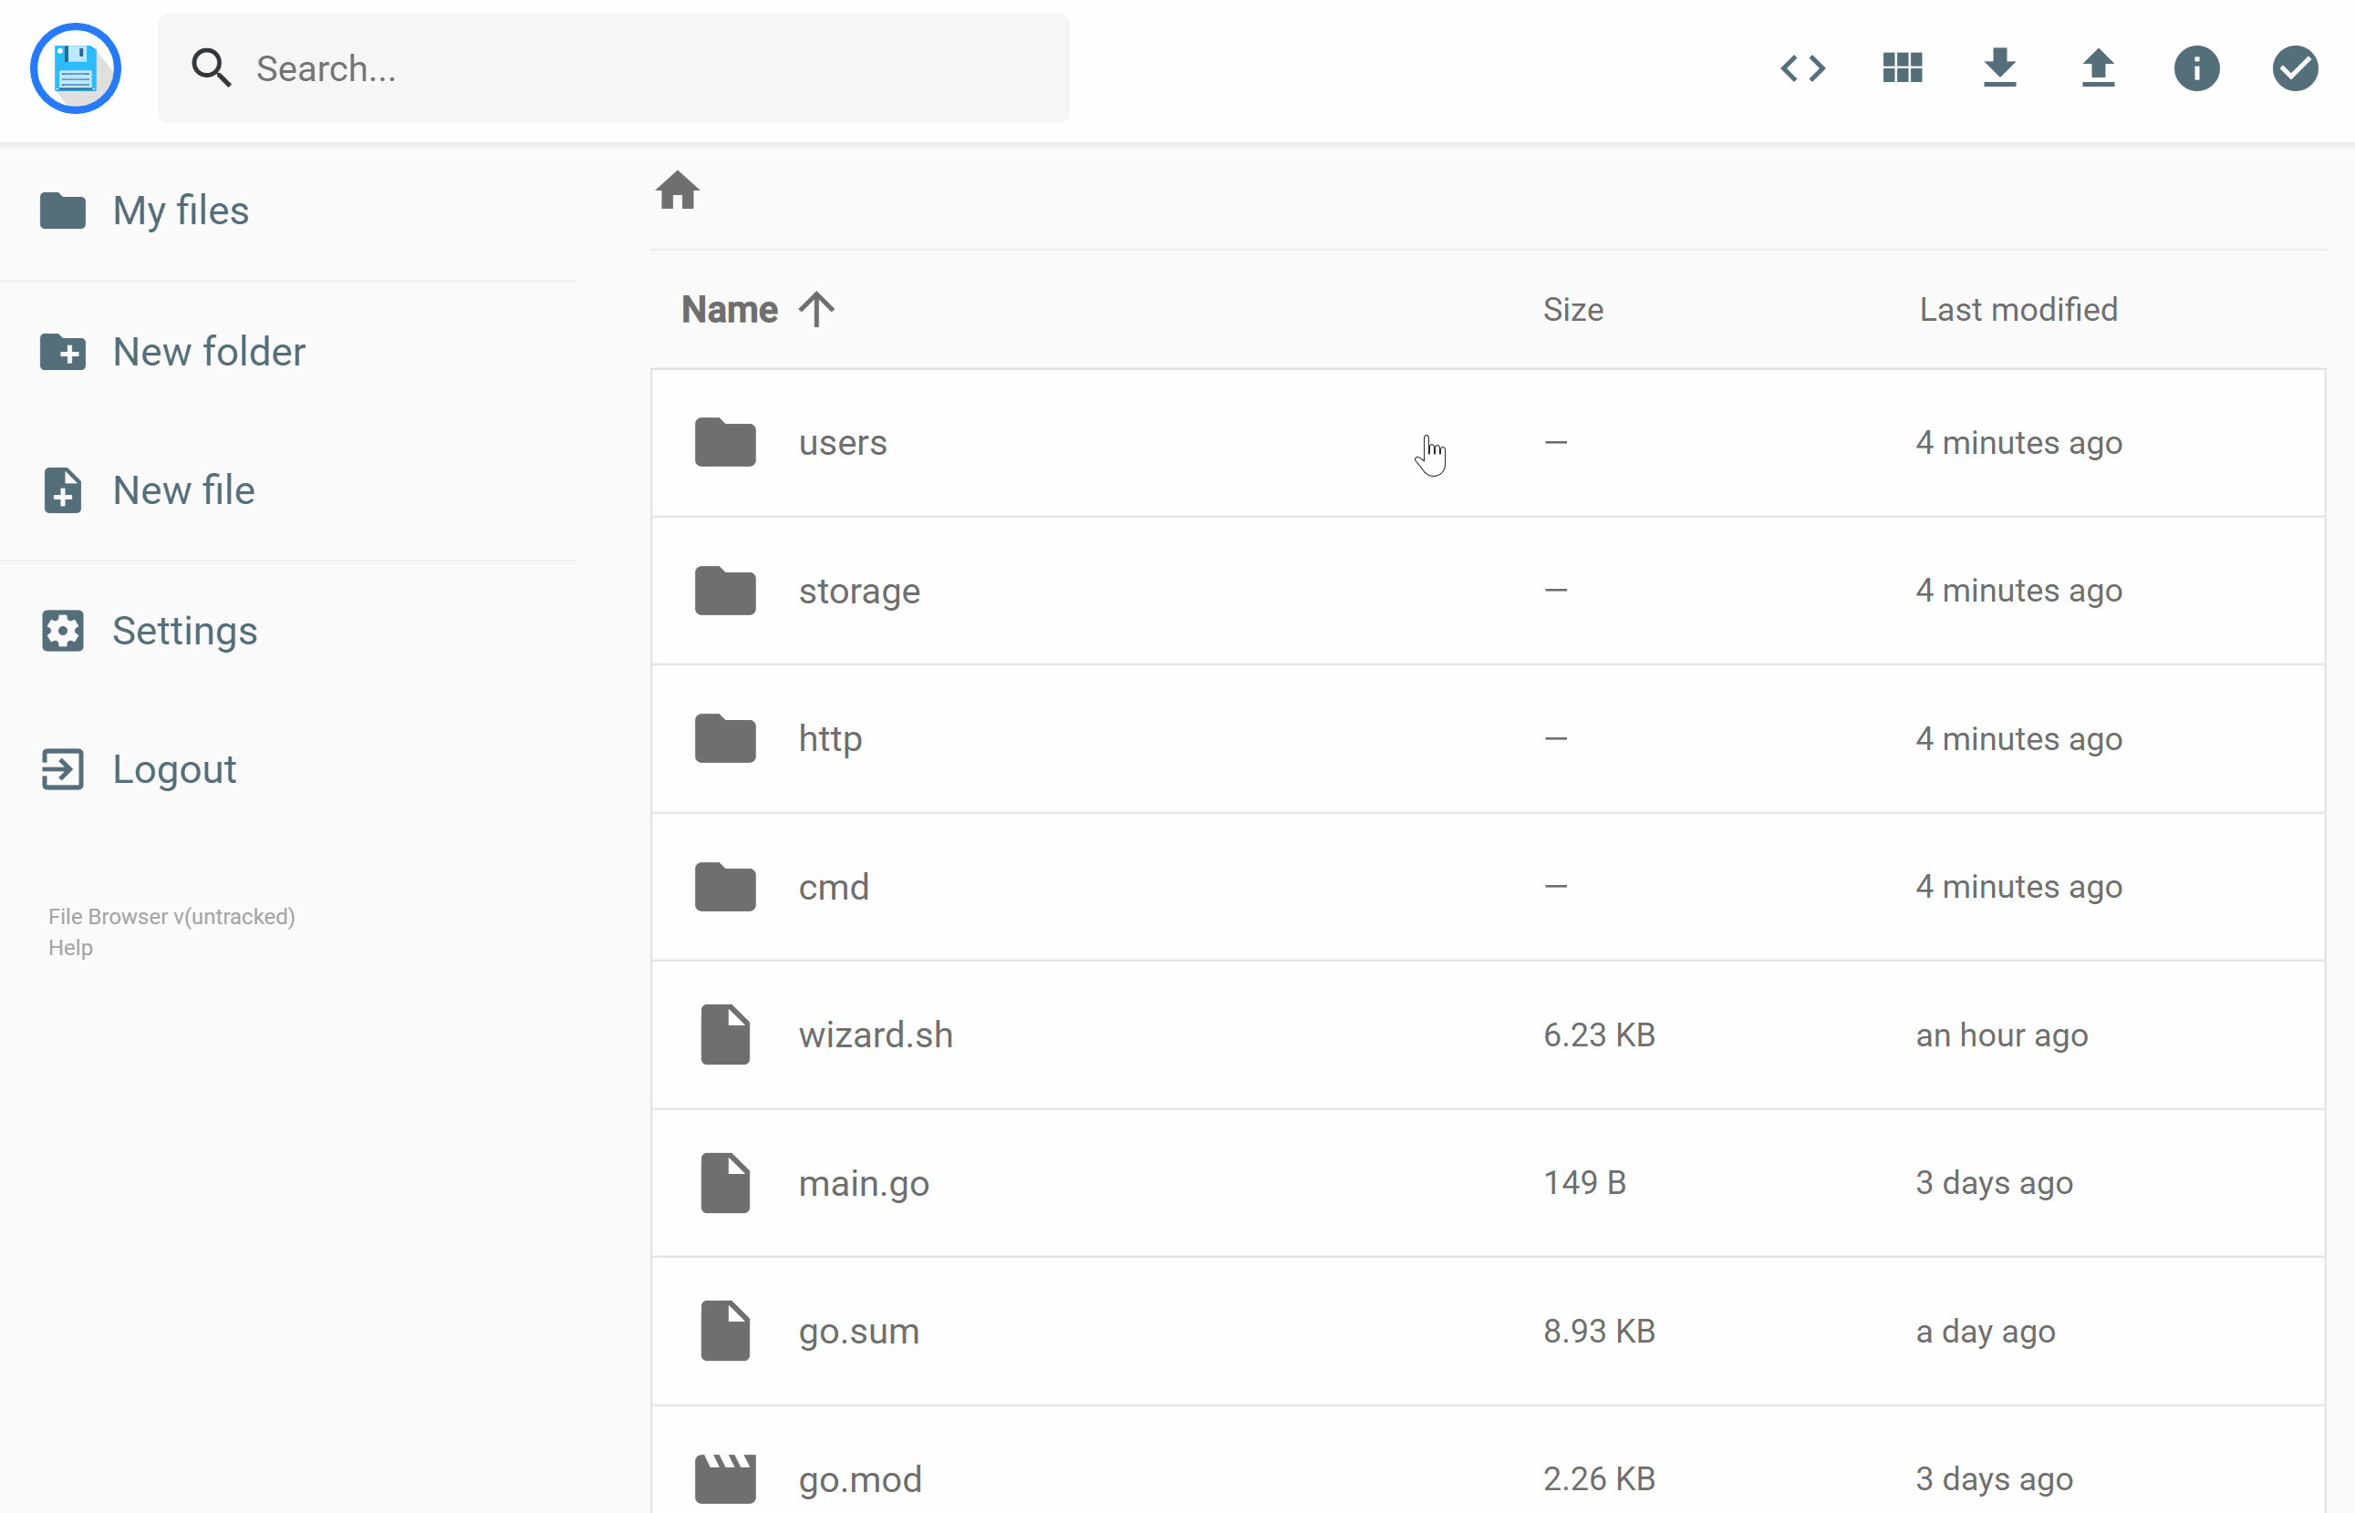

Docker Exercise Explanation of the exercise
Create a docker volume «filebrowser»
Run a filebrowser container:
Expose port 80 as 8080
Mount database.db in /database.db as File
Mount docker volume in /src
https://filebrowser.org/installation#docker
Notes:
Trick: docker volumes are mounted using –mount instead of –v
Image can be found in the docs: https://filebrowser.org/installation#docker

Slide 39
DOCKER EXERCISE «Gitea»

Slide 40
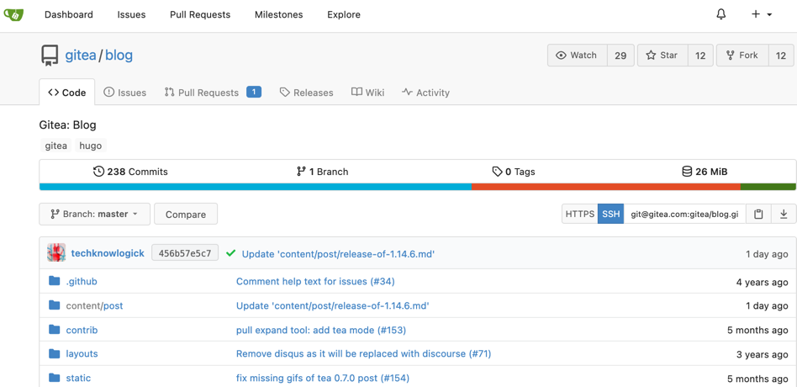

Docker Exercise Gitea – self hosted Git
Write a docker-compose file
docker-compose up -d
Finish the setup on http://localhost:3000 (don’t forget to create the admin user!)
Create and clone a repository
What happens when you stop the container?
https://docs.gitea.io/en-us/install-with-docker/
Notes:
If admin user forgotten: remove the /data dir and recreate the container to restart the installation OR register yourself in gitea as user and become admin (first user is admin by default)
Image can be found in the docs: https://docs.gitea.io/en-us/install-with-docker/

Slide 41
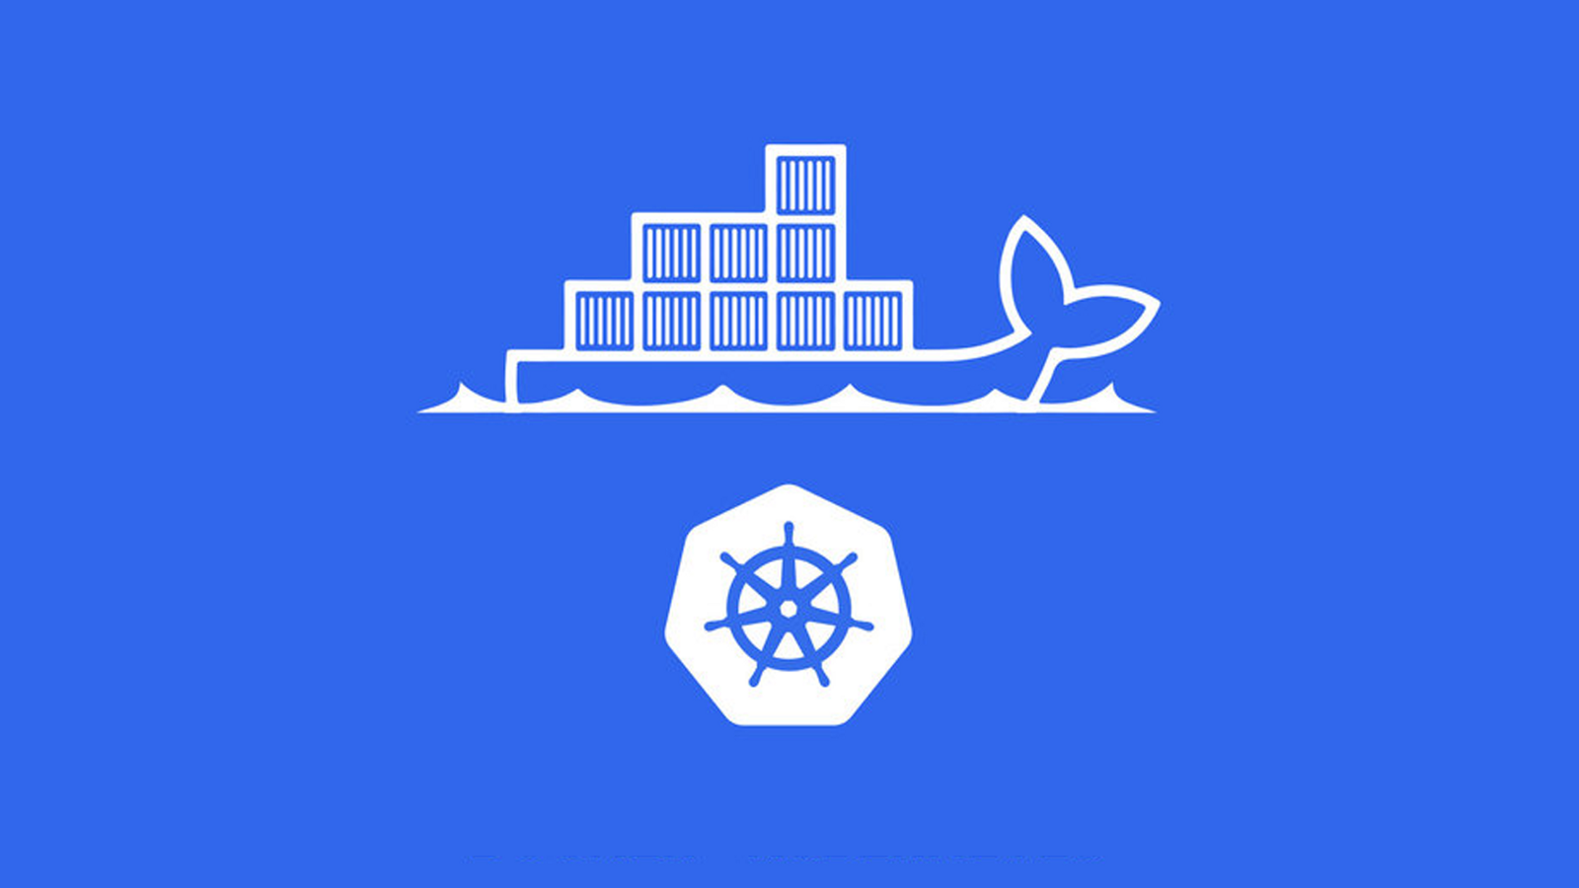

Kubernetes @

Slide 42
Kubernetes@Post Key Figures
Key figures
Running Container: 3’800
Used Container Nodes: 300
Application purpose
PostAuto Backend
Chatbot and Livechat
Postshop Backend
Automation and Logging Tools

Slide 43
Kubernetes Containerisation with K8S

Slide 44
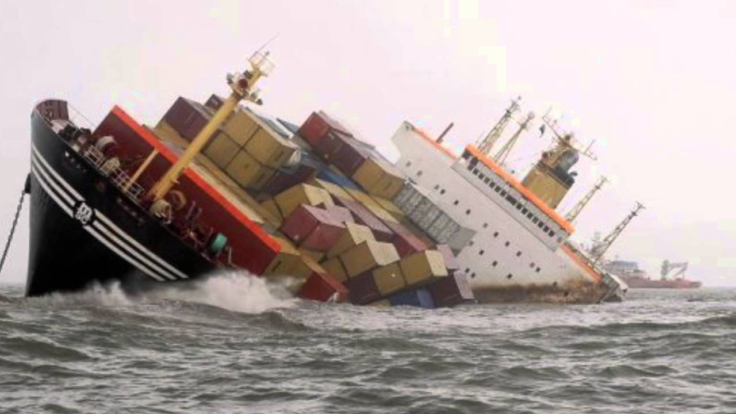
Kubernetes What Docker looks like in production

Slide 45
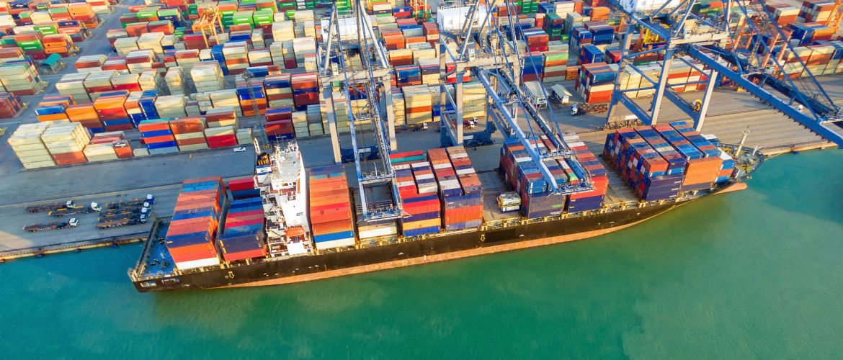
Kubernetes What Kubernetes looks like in production

Slide 46


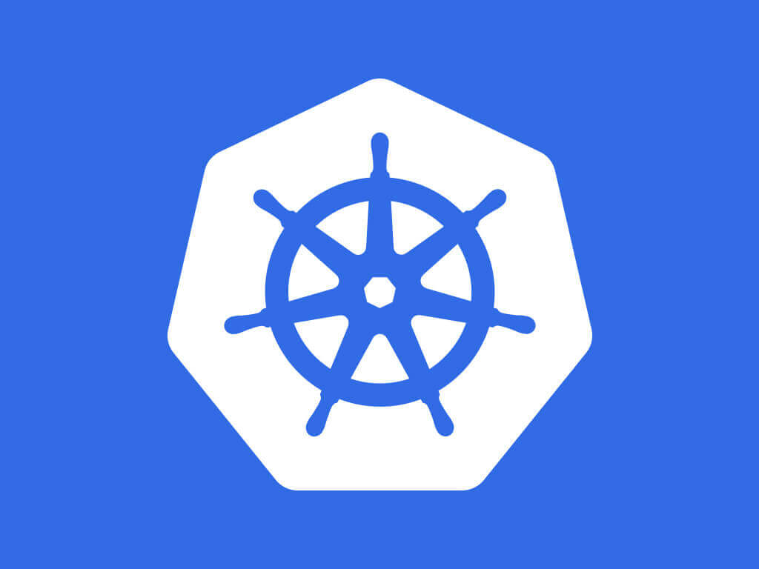
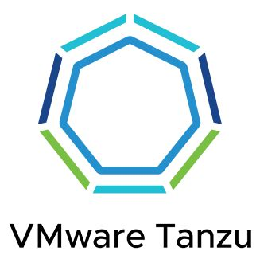

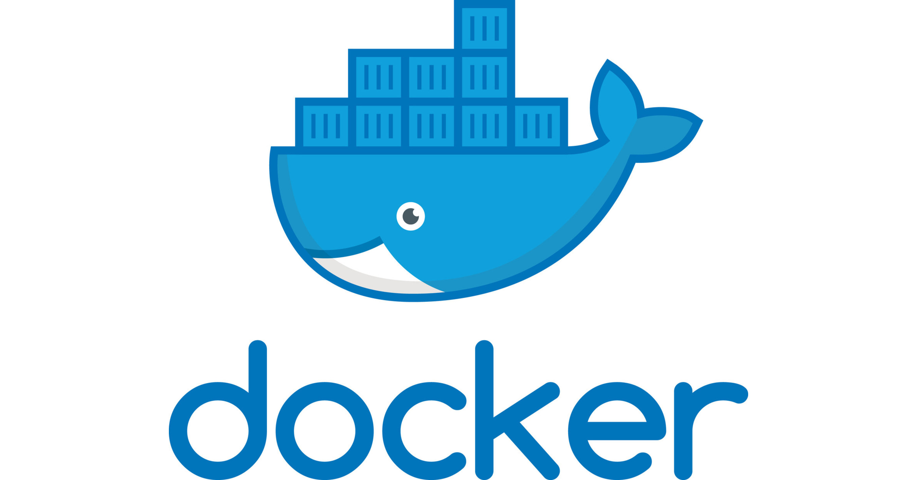


Kubernetes What is Kubernetes?
User Experience
kubectl
Orchestration
Container Engine
Container Host

Slide 47
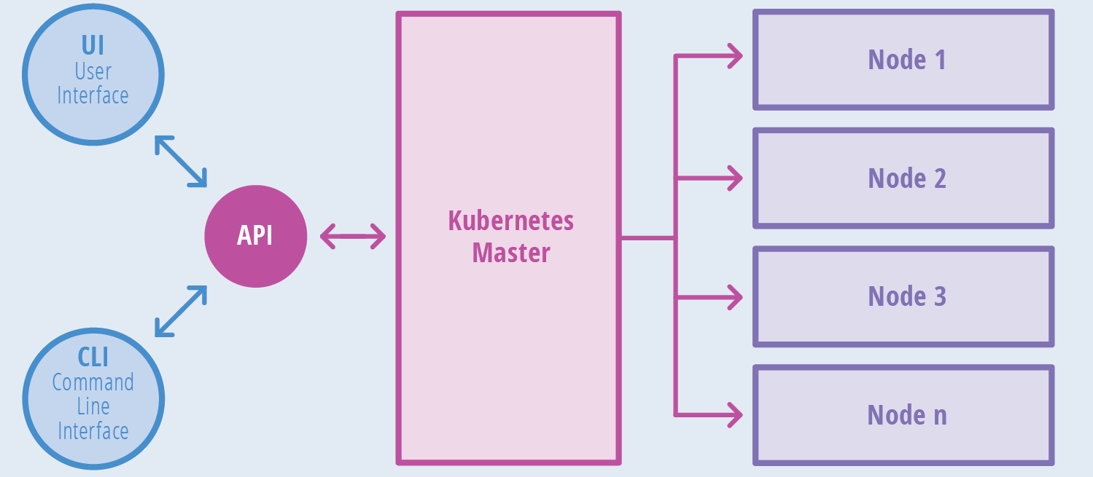
Kubernetes What is Kubernetes?
Notes:
Important: multiple servers, an API and a master that knows where which container is running

Slide 48


Kubernetes Live Demo
Live Demo
Notes:
Now get a demo of K8s. Featuring a K8s cluster deployed as you would deploy it for big production apps.
Show cluster on the cli (that we can cli from our node)
Show pods running (many pods spread over many servers)
Show ArgoCD having the knowledge of the App – Server view
Load
Server-View
Grafana Dashboard

Slide 49
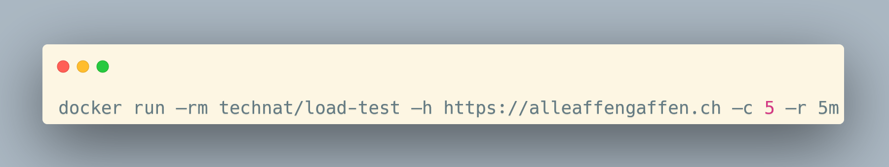
Kubernetes Live Demo – Load-Test
Notes:
Hit that command to give me some load!

Slide 50

Questions? mweng@post.ch

